Slide 1
HMM using forward and backward Algorithm

Slide 2
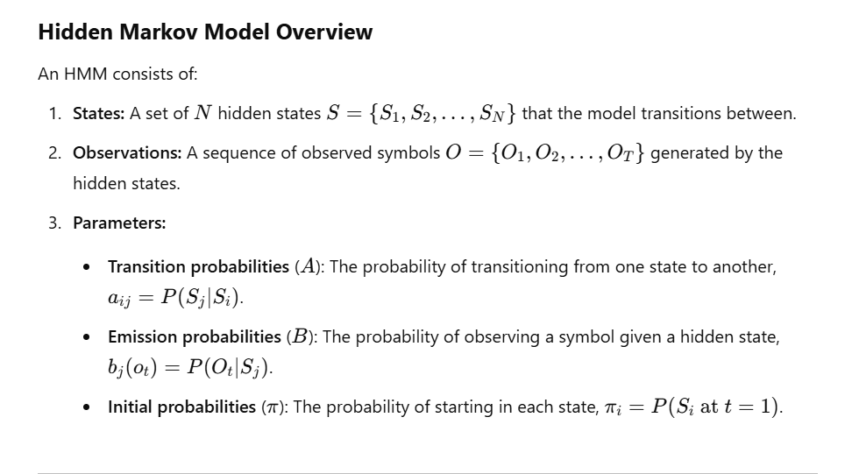

Slide 3
Forward Algorithm
The Forward Algorithm is used to calculate the probability of an observed sequence given the model. It computes the probability of ending up in each hidden state after observing a sequence up to a certain point.

Slide 4
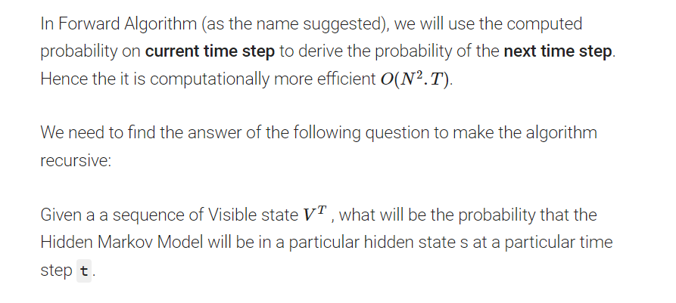
Forward Algorithm:

Slide 5
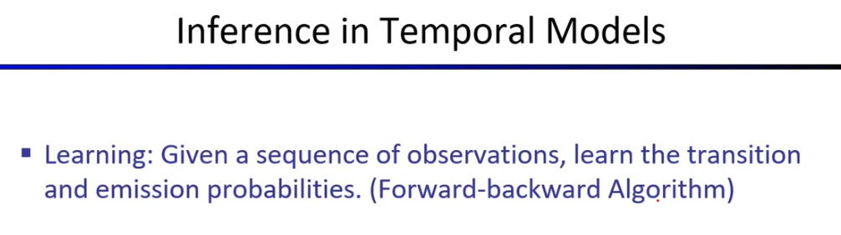

Slide 6
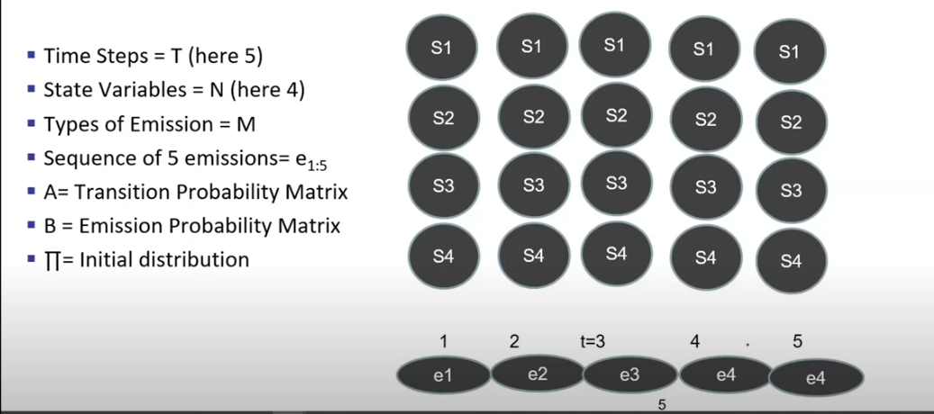
Description
e5

Slide 7
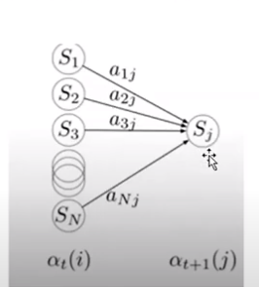
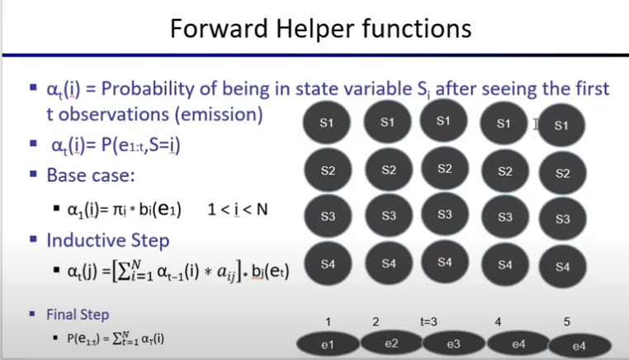
e5

Slide 8
Forward HMM

Slide 9
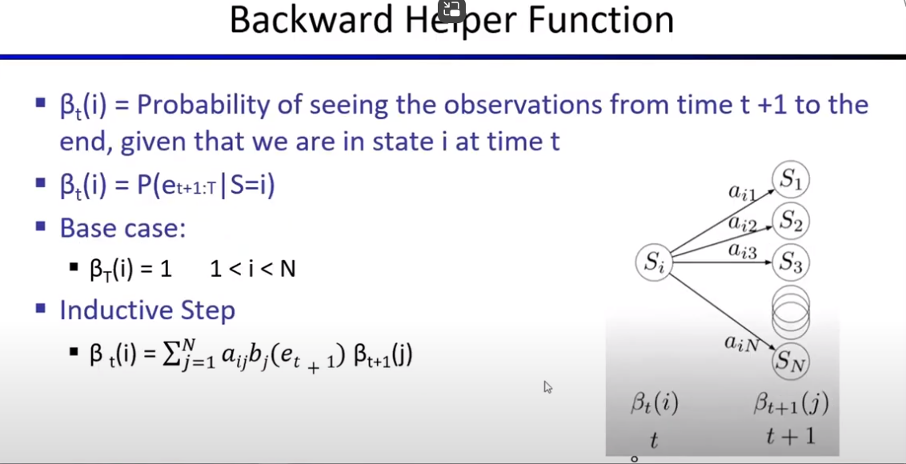

Slide 10
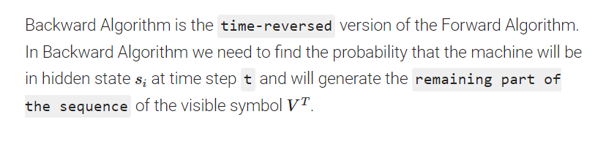
Backward Algorithm
Backward algorithm is similar except that we start from the last time step and calculate in reverse. We're finding the probability that from a given state, the model will generate the output sequence that follows.

Slide 11
Applications of HMMs and Forward-Backward Algorithms
Speech recognition: Decoding phoneme sequences.
Natural language processing: Part-of-speech tagging and named entity recognition.
Bioinformatics: Sequence alignment and gene prediction.
Time-series analysis: Anomaly detection and prediction.

